Slide 1
Employee Data Analysis using Excel
STUDENT NAME: ASWINI S
REGISTER NO: 312200828
DEPARTMENT: B.Com(General)
COLLEGE: Pachaiyappa's college for Women, Kanchipuram

Slide 2
PROJECT TITLE
Employee Turnover Analysis

Slide 3


AGENDA
Problem Statement
Project Overview
End Users
Our Solution and Proposition
Dataset Description
Modelling Approach
Results and Discussion
Conclusion
3/21/2024 Annual Review

Slide 4

PROBLEM STATEMENT
Turnover is the rate at which an employer gains and losses employees. The simple way to describe it is "how long employees tend to stay" or "flow rate through the revolving door." There are two types of turnover, which is voluntary and involuntary.

Slide 5
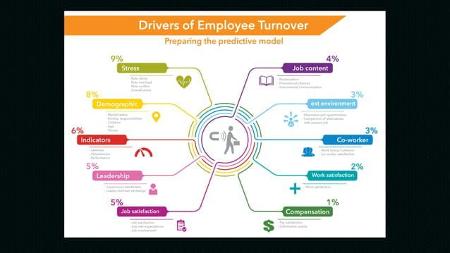

PROJECT OVERVIEW
.

Slide 6

WHO ARE THE END USERS?
The end users of employee turnover analysis are typically HR and managers: HR HR is responsible for tracking employee turnover and providing insights on trends. Managers Managers have the most power to prevent voluntary turnover by designing work environments that encourage people to stay. Employee turnover analysis can help identify reasons for employee turnover, such as unhappiness with management or lack of growth opportunities.

Slide 7
OUR SOLUTION AND ITS VALUE PROPOSITION
Here are some ways to analyze employee turnover: Calculate the turnover rate: The formula for calculating the employee turnover rate is: (number of employees who left / average number of employees) x 100. This rate can be calculated for a month, quarter, or year. Compare to industry benchmarks: Compare the turnover rate to industry benchmarks and historical data. Visualize the data: Use pie charts or column graphs to show the number of people who left and why they left. Use pulse surveys: Conduct shorter, more frequent surveys to track employee satisfaction and engagement. This can help identify potential issues before they become major problems.

Slide 8
Dataset Description
Here are some datasets and descriptions for employee turnover analysis: Employee Attrition Dataset This dataset includes information on employee demographics, job roles, compensation, work experience, and performance and satisfaction. It also includes an attrition status that indicates whether the employee has left the company. Employee Attrition Classification Dataset This dataset includes information on employee ID, age, gender, years at company, monthly income, job role, and work-life balance. HR Analytics Data Set This dataset includes information on employee satisfaction level, last performance review score, number of projects, average monthly hours, time spent with the company, work accident, and whether the employee left the company.

Slide 9
THE "WOW" IN OUR SOLUTION
Average monthly employment = 348.08
Total separation=54
Employee turnover=15.51%
3/21/2024 Annual Review
9

Slide 10
MODELLING
There are a number of ways to model employee turnover, including: Predictive analytics: Use factors like job role longevity, promotion history, and engagement scores to calculate a turnover risk score for each employee. This can help identify employees who are at risk of leaving. Machine learning models: Use historical employee data to predict turnover. Natural language processing (NLP): Analyze employee feedback and sentiment to predict turnover. Data mining: Identify hidden variables that influence employee turnover. Social network analysis: Identify influential employees and their potential impact on turnover.
10

Slide 11
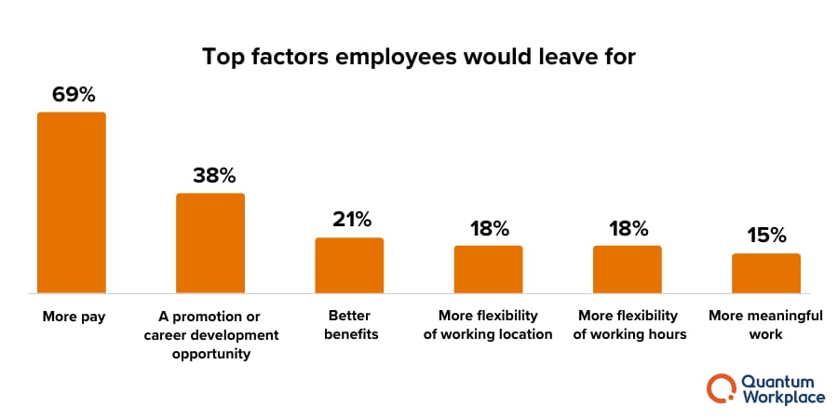
RESULTS
11

Slide 12
conclusion
Here are some conclusions about employee turnover analysis: Employee turnover analysis can help improve HR processes Understanding employee turnover can help HR professionals develop data-driven strategies to improve HR processes, reduce turnover, and create a thriving organizational culture. High turnover can indicate problems High employee turnover rates can indicate problems within a company or industry, such as poor working conditions, lack of advancement opportunities, or insufficient compensation.

